Slide 1
Examination Timetabling Automation using Hybrid Meta-heuristics Trabalho de projeto Ano letivo 2014/2015
Instituto superior de engenharia de lisboa
Mestrado em engenharia informática e DE computadores
Área Departamental de Engenharia de Eletrónica e Telecomunicações e de Computadores
Student: Miguel de Brito e Nunes
Supervisors: Artur Jorge Ferreira 02/12/2015
Nuno Miguel da Costa de Sousa Leite

Slide 2
Summary
The Timetabling Problem
Existing Approaches
ITC2007 Examination Timetabling Problem
System Architecture
Loader and Solution Initialization
Proposed Approach: Local Search
Experimental Results
Conclusions
Future Work

Slide 3
Goals of this project
First phase:
Study of techniques and solutions for the examination timetabling problem
Second phase:
Generation of timetables according to the ITC 2007 (International Timetable Competition) - examination timetabling track
Timetable Validator
Results comparison with the ITC 2007 – examination timetabling track competitors and more up-to-date approaches
Notes:
Explicar:
ITC2007
Gerador implementado (resumo)
Validator
Examination Timetable é explicado no slide seguinte
GUI é opcional

Slide 4
The Timetabling Problem (1/2)
Examination Timetabling
Course Timetabling
School Timetabling
Problem constraints:
Hard constraints – mandatory rules which must be followed, in order to obtain a feasible/valid solution
Soft constraints – non mandatory rules; if followed, the solution is improved; otherwise, it suffers some penalty
Notes:
Explicar:
Os 3 tipos de problemas
Os dois tipos de constraints

Slide 5
The Timetabling Problem (2/2)
Two possible formulations:
Search problem
Optimization problem
Possible types of solutions:
Feasible
Non feasible
Optimal
Sub-optimal
Notes:
Explicar:
Os dois tipos de formulações
A hipotese de fazer hibridação e que é o caso desta mesma approach
Todos os tipos de soluções

Slide 6
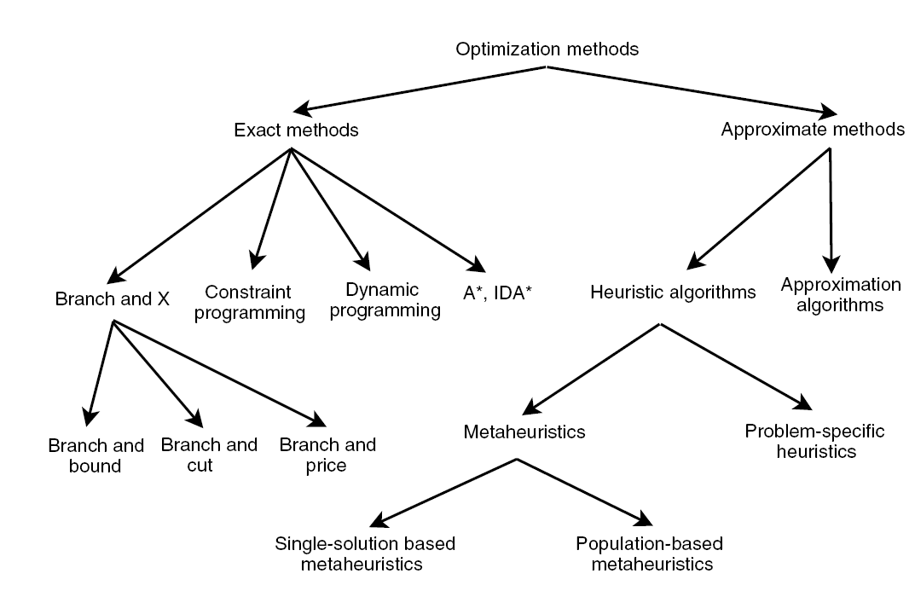
Existing Approaches
Exact Approaches
Approximation Approaches
Heuristics
Graph Coloring Based techniques
Pop Single-solution based meta-heuristics
Population based meta-heuristics
Notes:
Explicar:
O desenho
O facto de GCH pertencer a Problem-Specific Heuristics

Slide 7
Exact Algorithms
Search the whole space of solutions
It is guaranteed that an optimal solution is found
Inappropriate for relatively large sized problem instances
Algorithms
Branch-and-Bound
Constraint-Programming
Notes:
Explicar este tipo de algoritmo

Slide 8
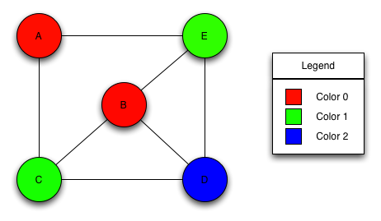
Graph Coloring Based Techniques
Problem-specific heuristic
Assign the minimum set of colors to an element type of the graph following certain constraints
Examples of Graph Coloring problems:
Vertex Coloring
Edge Coloring
Timetabling problems can be reduced to a graph coloring problem
Notes:
Explicar:
O algoritmo
Que é um problem-specific heuristic (como dito na imagem)

Slide 9
Meta-heuristics
General algorithmic frameworks, often nature-inspired, designed to solve complex optimization problems
In timetabling problems it is mostly used to optimize feasible solutions provided by problem-specific heuristics
Sub-types:
Single-Solution Based Meta-heuristics
Population-Based Meta-heuristics
Meta-heuristics for Multiobjective Optimization
Hybrid Meta-heuristics
Parallel Meta-heuristics
Notes:
Explicar:
Este tipo de heuristic
Os seus subtipos

Slide 10
ITC 2007 Examination timetabling problem (1/4)
12 different datasets
Ranking depends on the distance to feasibility and fitness values
The available execution time limit was set to 225 seconds, as measured by the benchmarking tool
Notes:
Explicar:
Este problema no geral (tem as suas próprias hard e soft constraints, objectivo é criar um horário final seguindo as regras de hard constraints….)
Que cada dataset tem diferentes dificuldades (detalhes sobre estes são dados no slide a seguir)
Explicar o benchmarking program
Hard constraints
The hard constraints are the following:
No student must be in more than 1 exam at the same time
Room’s capacity must not be exceeded
Exam’s length must not surpass the assigned time slot’s length
Exams hard constraints must be followed (e.g., 1 AFTER 2)
Rooms hard constraints must be followed (e.g., 1 ROOM_EXCLUSIVE)

Slide 11
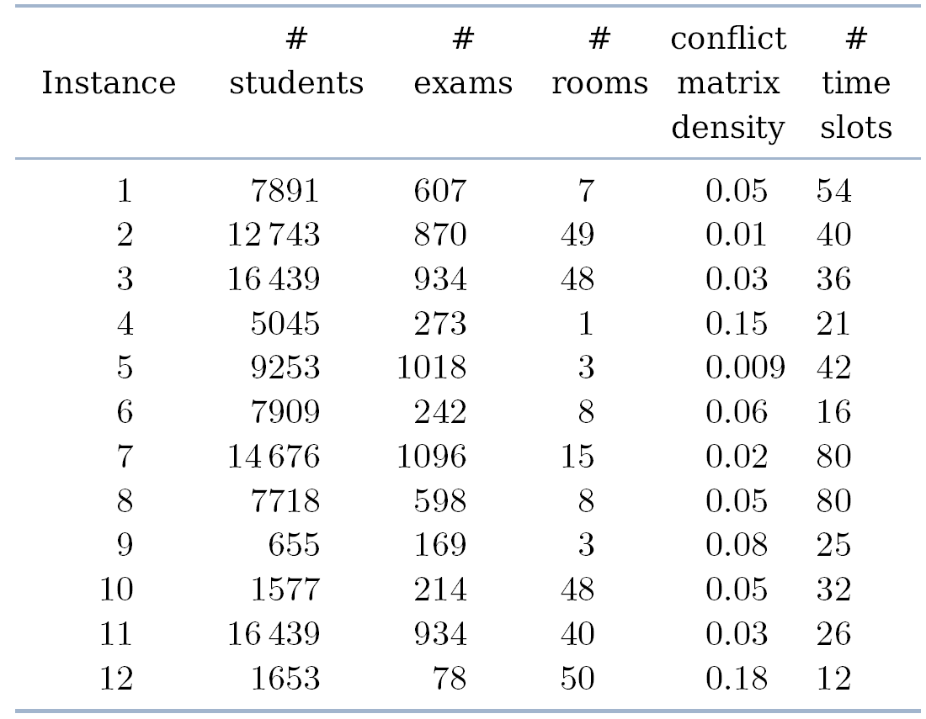
ITC 2007 Examination timetabling problem (2/4)
Benchmark data and specifications:
Notes:
Explicar o porquê de cada dataset ter a sua dificuldade e demonstrar exemplos

Slide 12
ITC 2007 Examination timetabling problem (3/4)
The hard constraints are the following:
No student must be in more than 1 exam at the same time
Room’s capacity must not be exceeded
Exam’s length must not surpass the assigned time slot’s length
Exams hard constraints must be followed (e.g., 1 AFTER 2)
Rooms hard constraints must be followed (e.g., 1 ROOM_EXCLUSIVE)

Slide 13
ITC 2007 Examination timetabling problem (4/4)
The soft constraints are the following:
Two exams in a row or in a day
Period spread
Mixed durations
Larger exams constraints
Room penalty
Period penalty
Notes:
Explicar cada um dos soft constraints

Slide 14
Proposed Solution
Graph Coloring
Simulated Annealing
Hill Climbing
Examination Timetable
ITC 2007 Data
Loader

Slide 15
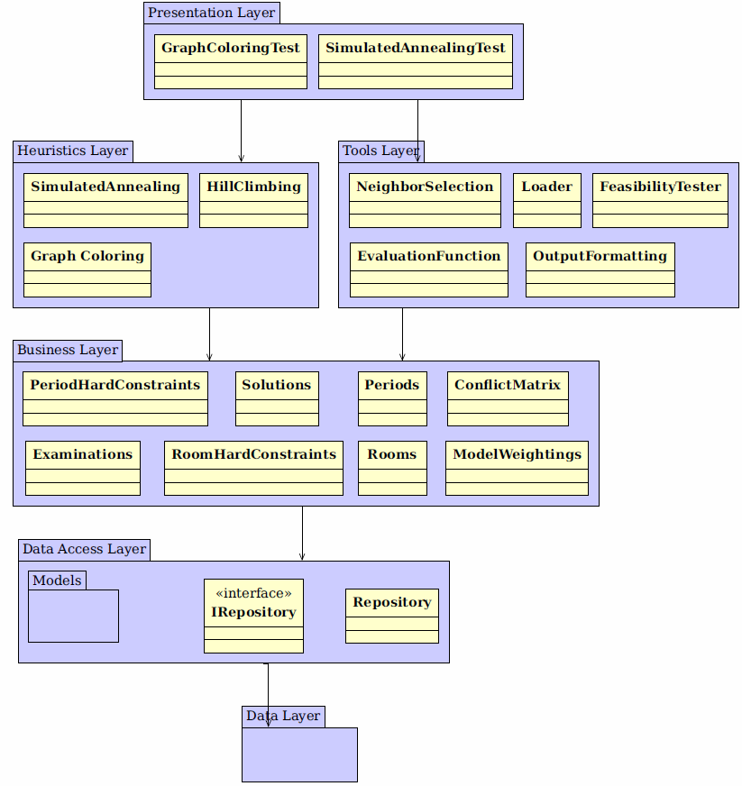
Proposed Architecture
Data Layer
Stores all entities (e.g., Examinations, timeslots
Data Access Layer
Provides repositories to access the stored entities
Business Layer
Provides functionalities to manipulate the repositories
All business classes implement the Singleton pattern
Heuristics Layer
Provides access to the implemented heuristics
Tools Layer
Tools used by the Heuristics Layer and higher layers
Presentation Layer
Notes:
Explicar cada camada separadamente e as suas ligações

Slide 16
Loader
Loads all the information from the dataset
Creates and populates the conflict matrix
Each dataset contains all the information required to create a solution:
Examinations and students’ enrollments
Rooms, their capacities and penalties
Periods and their penalties
Period and room hard constraints (optional)
Soft constraints
Notes:
Explicar:
Esta tool
O que está presente nos ficheiros dos datasets
Conflict Matrix

Slide 17
Graph Coloring
Generates an initial feasible solution
Largest Degree Ordering method is used
Implementation:
Populates and sort the assignment lists:
Unassigned examinations with room exclusivity hard constraint
Unassigned examinations with after hard constraint
Unassigned examinations with examination coincidence hard constraint
All other unassigned examinations
Examination assignment.
Normal assignment
Forcing assignment
230
110
422
75
621
954
13
755
18/04/2005 09:30:00
E: 107 R: 2
E: 202 R: 1
19/04/2005 09:30:00
E: 2 R: 5
20/04/2005 09:30:00
E: 112 R: 6
E: 254 R: 1
Notes:
Explicar:
Primeira heuristica a ser executada
Explicar LDO
Cada fase (com a ajuda da imagem)

Slide 18
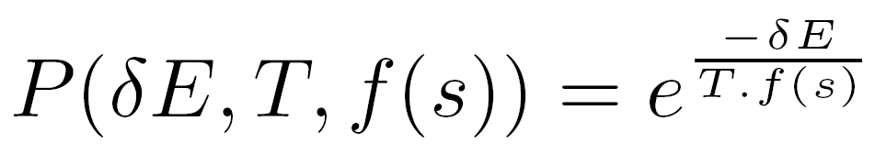
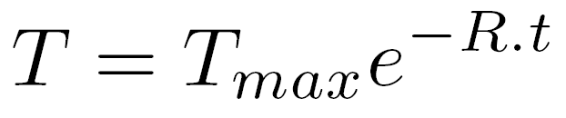
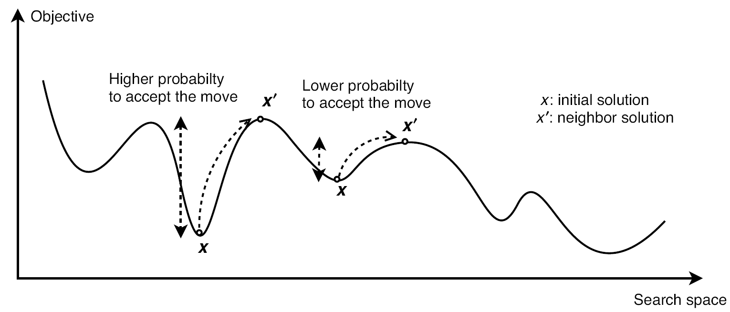
Simulated Annealing (1/2)
Neighbor operators generate neighbor solutions
Neighbor solutions’ acceptance criterion:
Exponential (decreasing) cooling schedule:
Parameters used in this meta-heuristic:
Maximum temperature
Minimum temperature
Number of iterations per temperature value
Temperature decreasing rate
Notes:
Explicar:
Esta heuristic
O que é acceptance criterion
Cooling schedule
Todos os parametros (com ajuda da imagem)

Slide 19
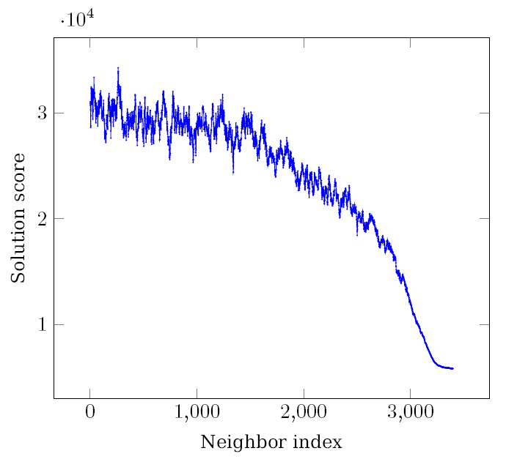
Simulated Annealing (2/2)
Parameters : TMax = 0.1, TMin = 1e-06, loops = 5 and rate = 16e-5
Results:
Notes:
Explicar o porquê deste resultado

Slide 20
Hill Climbing
Uses the same neighbor operators as the SA
Only accepts better solutions
It is time-monitored
Guarantees that the computation is finished within the given time limit
Notes:
Explicar:
A heuristica
O porquê da utilização desta heuristica

Slide 21
Neighborhood Operators
The implemented neighborhood operators:
Room Change
Period Change
Period & Room Change
Room Swap
Period Swap
Period & Room Swap
Notes:
Explicar:
Cada operador
Que a escolha é random e que foi implementado outro guiado mas que normalmente tem piores resultados
O ultimo operador foi implementado mas não foi usado – Explicar os testes feitos

Slide 22
Fitness computation
Fitness is computed incrementally
Takes advantage of the similarities between the solution and the generated neighbors
Results are obtained 19 times faster, exploring the solution space with more detail

Slide 23
Rate computation (Simulated Annealing)
The computation requires a simulation of the SA algorithm
A new rate is computed for each dataset
Rate is defined (by simulation) as a function of the dataset complexity, using almost the total available time
Higher likelihood of obtaining better results, compared to using a static rate

Slide 24
Experimental Results (1/2)
The results were obtained by averaging 10 runs for each dataset
The SA parameters were:
TMax = 0.1
TMin = 1e-06
reps = 5
rate = computed automatically

Slide 25
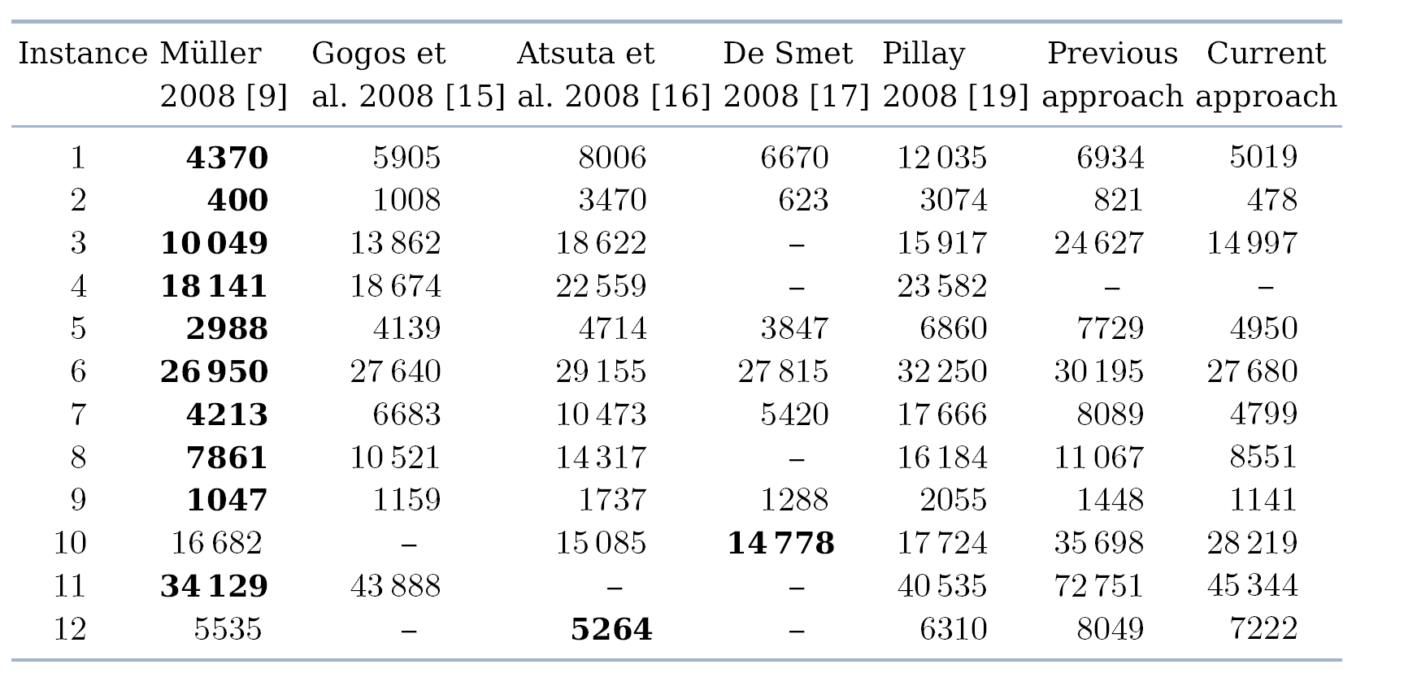
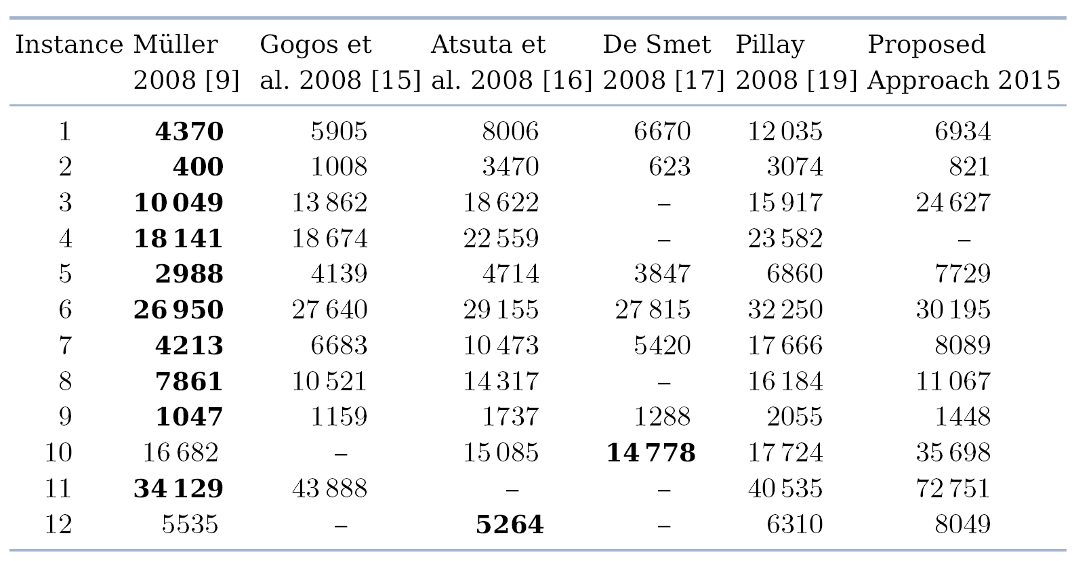
Experimental Results (2/2)
Notes:
Explicar que foi possível em alguns datasets obter resultados que são comparaveis aos 5 vencedores

Slide 26
Conclusions
A program was developed to generate timetables following ITC2007 rules, using heuristics:
Graph Coloring heuristic was developed to obtained a feasible solution
Simulated Annealing and Hill Climbing meta-heuristics were developed to improve the initial feasible solution

Slide 27
Future Work
Development of different approaches (e.g., adding the meta-heuristic Great Deluge to the current approach)
Modifications to the Graph Coloring technique to be able to get results for dataset 4
Change the behavior of Simulated Annealing to move examinations with exam_coincidence hard constraint

Slide 28
Tools and Techniques
Developed using .NET
C# Programming Language
Visual Studio 2013 was used as the development tool
The ReSharper extension was also used

Slide 29
The End
I hope you have enjoyed it!
Any questions?

